Slide 1
Implementing a Toy ML-KEM: A Study in Post-Quantum Computing
Alex Newcomb
CS 538

Slide 2
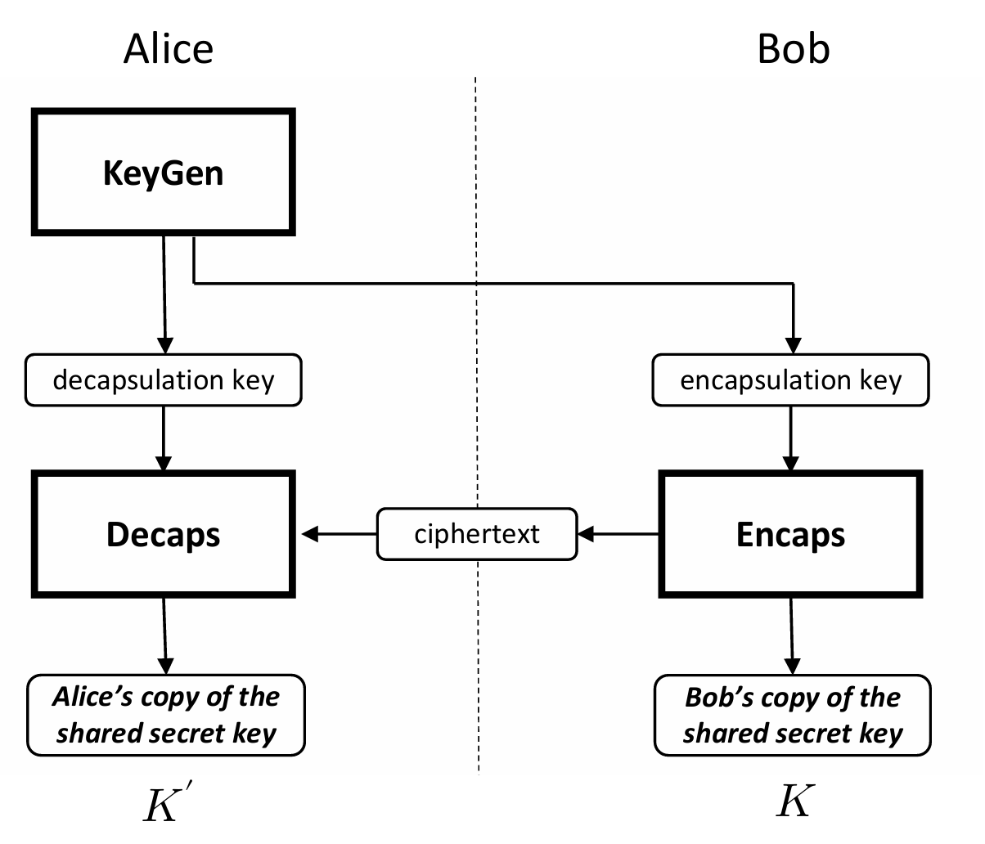
Introduction
ML-KEM = Module-Lattice Key Encapsulation Mechanism
Based on hardness of the Module Learning w/ Errors (MLWE) problem
Solving systems of noisy linear equations
Quantum resistant
Post-quantum algorithm for key sharing (symmetric key cryptography)
National Institute of Standards and Technology, "Module-Lattice-Based Key-Encapsulation Mechanism Standard," Gaithersburg, MD 20899-8900, 2024.

Slide 3
Objective
Generate a toy version of the algorithm
Python
Code available on GitHub:
https://github.com/newcomb-alex/toy-ml-kem
Objective:
Learn about the ML-KEM algorithm
Experiment with:
Decapsulation rate
Runtime of the toy algorithm

Slide 4
Scope
Scope:
Toy parameter set
No Number-Theoretic Transform (NTT) for multiplication
Simple ring multiplication with modulus instead
Simplified noise sampling (Centered Binomial Distribution) as opposed to NTT sampling
Operations over python structures rather than byte strings
Not focused on computational efficiency

Slide 5
Parameters
Set | n | q | k | η1​ | η2 | du | dv
A - Very Small | 16 | 97 | 2 | 2 | 2 | 4 | 4
B - Medium | 32 | 257 | 2 | 2 | 2 | 5 | 5
C - Large | 64 | 769 | 2 | 2 | 2 | 6 | 6
D - Very Large | 128 | 3329 | 2 | 2 | 2 | 7 | 7
Real Params (ML-KEM-512) | 256 | 3329 | 2 | 3 | 2 | 10 | 4
n – Polynomial degree (how many coefficients each polynomial has). Sets vector lengths.
q – Modulus for all ring arithmetic, so every coefficient is reduced modulo q. Sets scaling for compression and decompression.
k – Module dimension (size of vectors/matrices of polynomials). Determines the size of matrix A (k x k), secret/error vectors
η1 – Noise control for larger noise samples. Used for sampling secret terms in keygen and encryption.
η2 – Noise control for small encryption noises. Used during encryption via CBD sampling
du/dv – bit widths used to compress coefficients in the ciphertext component

Slide 6
Technical Implementation: ML-KEM
mlkem_keygen()
Generates a seed used for deterministic key generation
Public encapsulation key, ek, comes from public key encryption scheme (kpke)
Private decapsulation key, dk, comes from dk_kpke, ek, hash of ek, and z
mlkem_encaps(ek)
Input: ek, random message m
Output: c (ciphertext), K (shared secret)
Binds m to the public key by hashing (m || H(ek)) and expanding it into K, r
K = secret key
r = encryption randomness
Ciphertext calculated by encrypting ek, m with r

Slide 7
Technical Implementation: ML-KEM
mlkem_decaps(dk, c)
Input: secret decapsulation key, ciphertext c
Output: shared secret key K’
Follows Fujisaki-Okamoto process (FO Transform)
Decrypt ciphertext to recover candidate message m’
Recompute what encapsulation should have produced from that m’
Check whether the given ciphertext is consistent
If valid, return the “real” shared key
If invalid, return a fallback pseudorandom key

Slide 8
Technical Implementation: KPKE
kpke_keygen(seed)
Generates two keys for the public key encryption component
Public/encryption key: ek = {rho, t}
Private/decryption key: dk = {s}
Steps:
Expand one input into two seeds
Rho for public matrix A, sigma for small secret/noise polynomials
Build a deterministic matrix A from rho
Sample secret vectors s and e
Compute t = (A ⋅ s + e)
Return rho, t. Keep s secret

Slide 9
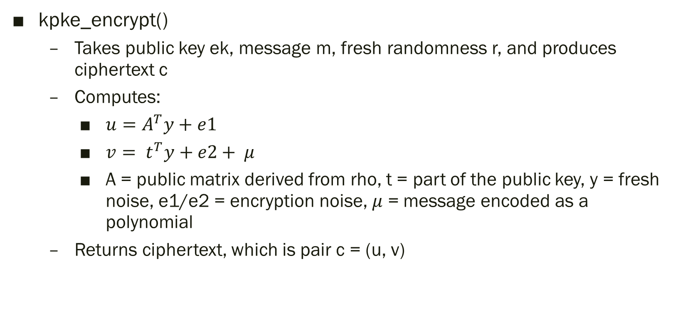
Technical Implementation: KPKE
kpke_encrypt()
Takes public key ek, message m, fresh randomness r, and produces ciphertext c
Computes:
$u=A^{T}y+e1$
$v= t^{T}y+e2+ μ$
A = public matrix derived from rho, t = part of the public key, y = fresh noise, e1/e2 = encryption noise, $μ$ = message encoded as a polynomial
Returns ciphertext, which is pair c = (u, v)

Slide 10

Technical Implementation: KPKE
kpke_decrypt()
During decryption, holder of the secret key s computes:
$w=v − s^{T}u$
So, w ideally becomes $μ,$ which is converted back to the original message bits

Slide 11
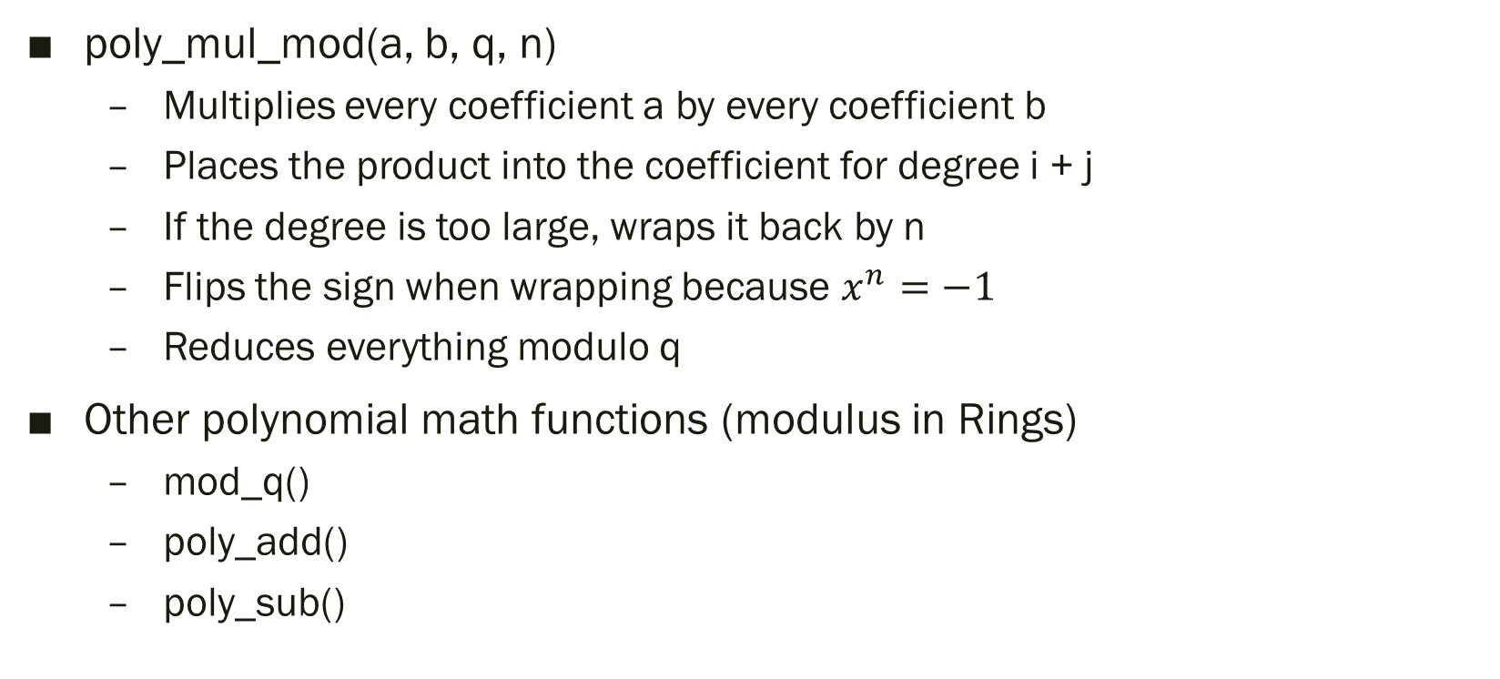
Technical Implementation: Math Utilities
poly_mul_mod(a, b, q, n)
Multiplies every coefficient a by every coefficient b
Places the product into the coefficient for degree i + j
If the degree is too large, wraps it back by n
Flips the sign when wrapping because $x^{n}=−1$
Reduces everything modulo q
Other polynomial math functions (modulus in Rings)
mod_q()
poly_add()
poly_sub()

Slide 12
Challenges
Mathematics was challenging to understand
Required a couple weeks of reading to gain a basic understanding
Therefore, challenging to implement/fully understand within the code
ML-KEM has many operations and functions to keep track of
Also a challenge for implementation, as it was difficult to remember all low-level details

Slide 13
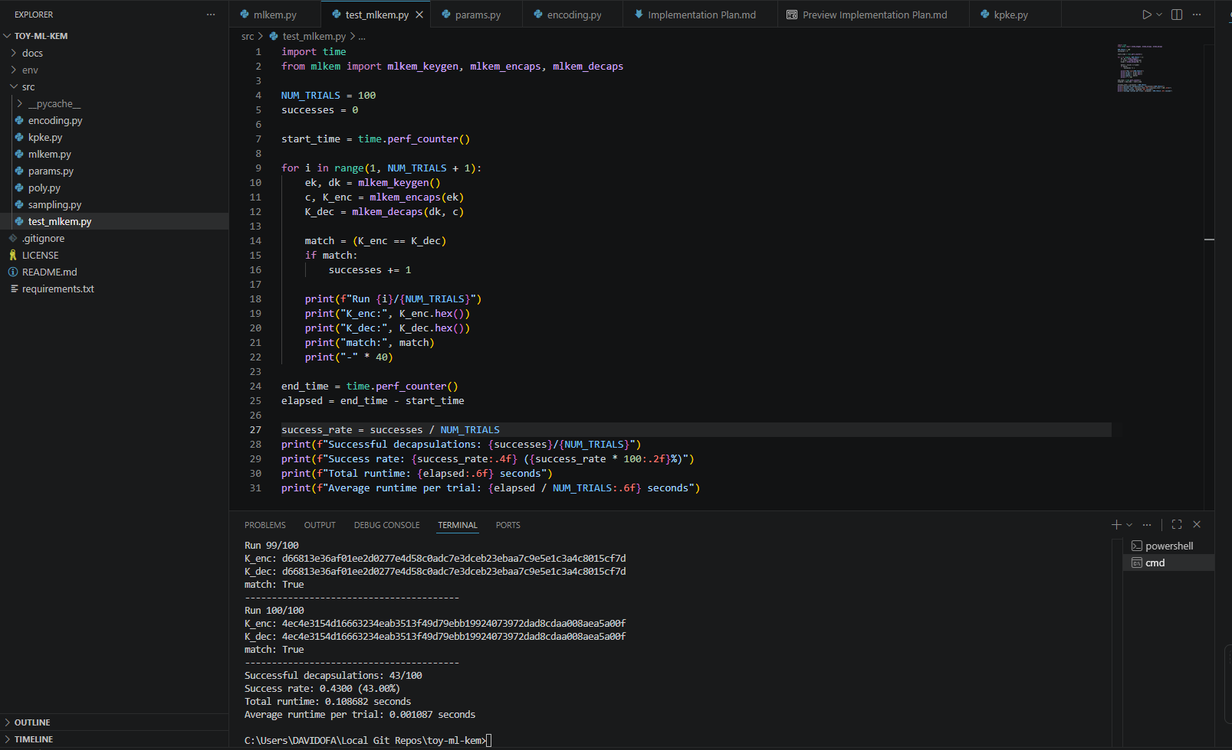
Live Demo (Performed in Class)

Slide 14
Results and Analysis
100 trials per set

Slide 15
Results and Analysis
Decapsulation success rate increased and reached 100% with larger parameter sets
Low success rate on smallest set size
Notably performed well on real parameter set
Runtime increased with larger parameter sets
Significantly increased with real parameter set
Runtime overall remained fast

Slide 16
Conclusion
Successfully implemented a toy ML-KEM
Learned the mathematics behind ML-KEM
Studied the decapsulation rate and runtime of my implementation
Decapsulation rate became 100% on larger parameter sizes (including real)
Runtime remained fast for my implementation
Lessons learned:
ML-KEM math is very challenging. Scoped out NTT and simplified operations
Mastery of ML-KEM would require months of study

Slide 17
References
[1] | National Institute of Standards and Technology, "Module-Lattice-Based Key-Encapsulation Mechanism Standard," Gaithersburg, MD 20899-8900, 2024.

Slide 18
Questions? Comments? Concerns?

